Slide 1
Global Inequality
Do we all deserve the same things?

Slide 2
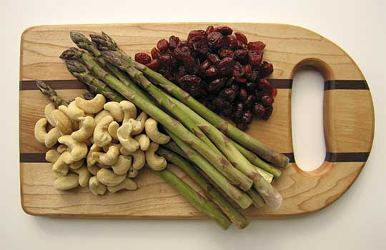
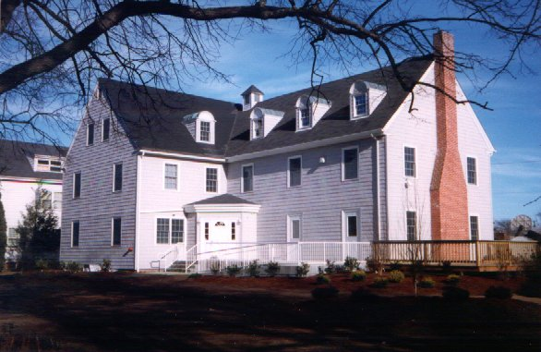
What do we deserve?
Food?
Clothing?
Shelter?
Ipods?
Cars?
Computers?
Vacations?

Slide 3
What we’ll do
Discover facts
Examine causes
Check out effects
Spotlight home
Explore solutions
Challenge our perceptions
Create a comprehensive evaluation

Slide 4
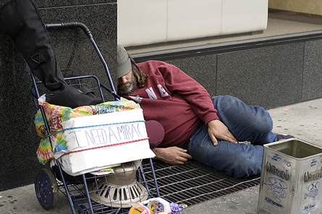
Grand debate
Human rights
International politics
Trade agreements
Sustainability
Fair trade
External Debt
Military Spending

Slide 5
What is “poor”?
Brainstorm list of needs and wants.
How much do you need to earn for these?
Imagine: Living on <$2/day
½ of the world lives on such an income.
In the US, what will $2 buy you?
Let’s say in China…..

Slide 6
Definitions of poverty
2 types of poverty
Absolute poverty- living below a federally defined “poverty line”.
In US, the “poverty line” is:
Individual annual income: $9,973
Family of 4 annual income: $19,971
Other countries have different poverty lines.

Slide 7
Definitions of Poverty
Relative poverty takes every person, every income and ranks them. The bottom 10% would be considered relatively poor.
If the median household in a wealthy neighborhood earns $1 million each year, then a family which earns "only" $100,000 would be considered poor on the relative poverty scale.

Slide 8
How does this work?
Can we compare relative poverty levels across nations?
Can we create a global absolute poverty level?
World Bank has set a global poverty line of $2/day.
Does this work for developed nations?
This only counts income. What other factors might be important?

Slide 9
Here is what we do:
Use GDP data and income distribution data to assign a level of income to each person in the world.
Examine inequality within and between countries.
Within- how the income is spread among a country’s citizens.
Between- wealth differences of different nations.

Slide 10
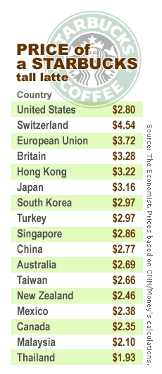
Tall Latte Index
Measures price differences and currency values between countries.
Helps us understand the differences between countries.
We’ll set this issue aside from here….

Slide 11
Facts and Stats
The GDP of the poorest 48 nations is less than the wealth of the world’s three richest people combined.
Nearly a billion people entered the 21st century unable to read a book or sign their names.
Less than one per cent of what the world spent every year on weapons was needed to put every child into school by the year 2000 and yet it didn't happen.
The poorer the country, the more likely it is that debt repayments are being taken from people who never received any of the money.

Slide 12
Facts and Stats
In 1960, the 20% of the world’s people in the richest countries had 30 times the income of the poorest 20% — in 1997, 74 times as much.
An analysis of long-term trends shows the distance between the richest and poorest countries was about:
3 to 1 in 1820
11 to 1 in 1913
35 to 1 in 1950
44 to 1 in 1973
72 to 1 in 1992

Slide 13
Facts and Stats
Approximately 790 million people are chronically undernourished.
They “die quietly in some of the poorest villages on earth, far removed from the scrutiny and the conscience of the world. Being meek and weak in life makes these dying multitudes even more invisible in death.”
According to UNICEF, 30,000 children die each day due to poverty. That is 210,000 children each week, or just under 11 million children under five years of age, each year.

Slide 14
Facts and Stats
Water problems affect half of humanity:
1.1 billion people in developing countries have inadequate access to water, and 2.6 billion lack basic sanitation.
1.8 million children die each year from diarrhea
Close to half of all people in developing countries suffer at any given time from a health problem caused by water and sanitation deficits.
Millions of women spending several hours a day collecting water.

Slide 15
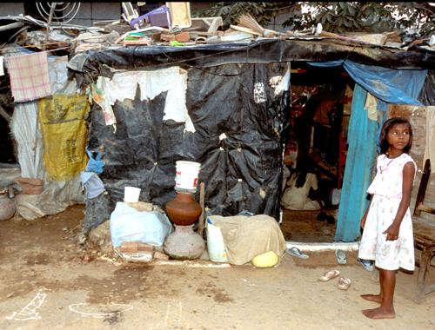
Facts and Stats
The richest 50 million people in have the same income as 2.7 billion poor people.
The world’s billionaires have a wealth greater than the incomes of the poorest half of humanity.

Slide 16
Global Spending Priorities
Consider the global priorities in spending
Cosmetics in the US: 8 billion
Ice cream in Europe: 11 billion
Perfumes in Europe and the US: 12 billion
Pet foods in Europe and the US: 17 billion
Military spending: 780 billion

Slide 17
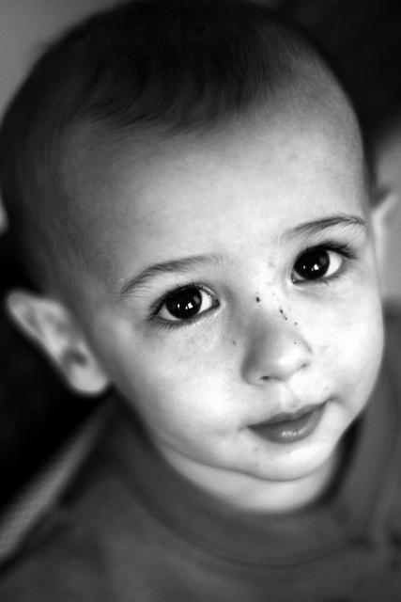
Consider the possibilities
To make some things happen globally
Basic education for all 6 billion
Water and sanitation for all 9 billion
Reproductive health for all women 12 billion
Basic health and nutrition 13 billion

Slide 18
Poverty Presentation
Research and educate the class on ONE major cause of poverty in assigned groups.
Similar to prior presentations except:
Convince us that yours is the LEADING cause.
5-10 minutes including power point.
All people must speak and play active role.
Due Thursday 2.7
Groups of 3, you pick cause.

Slide 19
Causes and Factors
Government corruption-Sasha, Trenton, James
Trade- Briley, Dev, Gigi
Social inequality- Trevor, Abby, Haley
Environmental degradation- Costa, Hendricks
Overpopulation- Danae, Daniella, Lia
High cost of living- Carson, LM, MC
Education (lack of)- Merv, Richard Maberto 3, Jaimie
Natural disasters-Ant, Moi
Healthcare/Disease- Kayla, Brooklyn Maddie

Slide 20
Presentation Format
Thesis
Facts about poverty
Facts about your cause
Story
Review
Conclude
Must include 5-10 slides with pictures
Must include 1 relevant graph, table or chart
PERSUASIVE IN NATURE

Slide 21
IMPORTANT NOTE
Each time I see a person wasting time (cell phone, etc.) that person loses 10 points for their entire group.

